Slide 1
Using Data-Driven Technologies for Smarter Urban Living
Big Data in Smart Cities
Murariu Tudor cristian

Slide 2

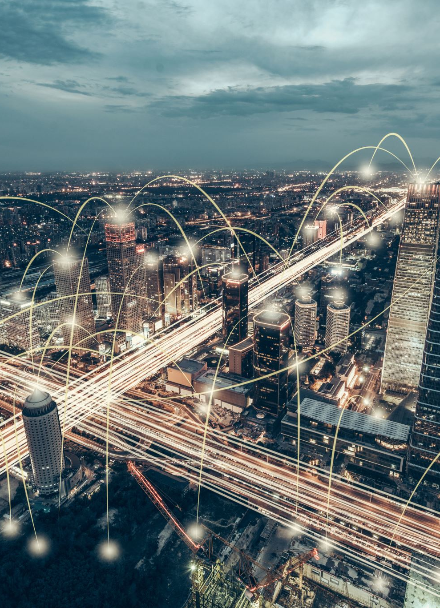
What Is a Smart City?
A smart city uses digital technologies and data analysis to improve:
Quality of life for citizens
Efficiency of urban services
Environmental sustainability
Decision-making by city authorities
Smart cities rely heavily on Big Data collected in real time.

Slide 3
Why Big Data Is Essential
Modern cities generate massive amounts of data every second.
Big Data enables:
Real-time monitoring of city operations
Predictive analytics for future planning
Automated and optimized public services
Faster and more accurate decisions
Without Big Data, smart cities cannot scale efficiently.

Slide 4
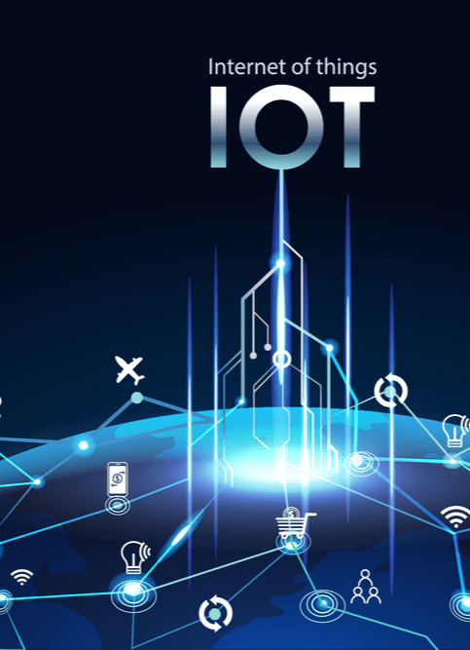
Sources of Big Data in Smart Cities
Smart cities collect data from multiple sources, including:
IoT sensors (traffic, pollution, weather)
Traffic cameras and GPS systems
Smart meters for water, gas, and electricity
Mobile devices and applications
Social media and citizen platforms
These sources generate continuous and diverse data streams.

Slide 5
Big Data Characteristics
Smart city data is defined by the 3Vs of Big Data:
Volume – extremely large datasets from millions of devices
Velocity – data generated and processed in real time
Variety – structured, semi-structured, and unstructured data

Slide 6

Big Data Technologies Used
Hadoop – distributed storage of massive datasets
Apache Spark – fast, in-memory data processing
Apache Kafka – real-time data streaming
Cloud platforms – scalable storage and computing resources
These tools enable reliable and scalable data processing.

Slide 7
Algorithms Used in Smart Cities
Clustering algorithms – identifying traffic or usage patterns
Time-series forecasting – predicting energy demand or traffic flow
Machine learning models – classification and prediction tasks
Anomaly detection – detecting faults or unusual behavior

Slide 8
Use Case: Smart Traffic Management
Big Data improves traffic systems by:
Monitoring traffic flow in real time
Predicting congestion before it occurs
Optimizing traffic-light timing
Reducing travel time and fuel consumption

Slide 9

Use Case: Smart Energy Management
Monitor consumption patterns
Predict peak energy demand
Optimize energy distribution
Reduce waste and operational costs
Smart energy management supports sustainable urban development.

Slide 10

Challenges in Smart Cities
Despite its benefits, Big Data introduces challenges:
Data privacy and citizen surveillance concerns
Cybersecurity risks
High infrastructure and maintenance costs
Integration of data from different sources
Addressing these challenges is essential for long-term success.

Slide 11

Conclusion
Big Data is the foundation of smart cities.
By combining advanced technologies and
intelligent algorithms, cities can:
Operate more efficiently
Become more sustainable
Respond better to citizens’ needs
Smart cities represent the future of urban living.

Slide 12
Thank you!

